Slide 1

CAPSTONE PROJECT -II
Lightweight Deep Learning Models for Marine object Classification
GUIDE-KUSUMA J
PAIDIMARRY SUMANJALI-2022BCSE07AED412
MELAPAKULA NIRAJAN-2022BCSE07AED384
SOMULA MANISH REDDY-2022BCSE07AED542
V S ROHINI-2022BCSE07AED521

Slide 2
ABSTRACT
The accurate and efficient classification of marine objects is vital for marine research, conservation, and environmental monitoring. Traditional manual methods are resource-intensive and unscalable, while many advanced deep learning solutions suffer from high computational demands, hindering real-world deployment. This project presents a novel, web-based application addressing these limitations. It comparably utilizes three lightweight deep learning models—MobileNetV2, EfficientNet-B0, and a custom CNN—to classify images across five marine categories: Dolphin, Fish, Lobster, Octopus, and Sea_horse. Our system delivers real-time predictions with confidence levels, offering side-by-side comparative outputs to enhance transparency and interpretability in AI decision-making. By prioritizing computational efficiency and user accessibility through a modern web interface, this work establishes a robust and interpretable tool poised to significantly advance marine monitoring and conservation, even on resource-constrained platforms.

Slide 3
PROBLEM STATEMENT
Marine organisms are still classified manually, which is time-consuming and not scalable for large image datasets.
Many deep learning models used for image classification are computationally heavy and require high GPU power and memory.
These models are difficult to deploy on resource-limited devices such as underwater cameras, drones, and edge systems.
Most AI systems provide only a single prediction without transparency, making it hard to understand model confidence.
Therefore, there is a need for a lightweight, efficient, and transparent AI system for marine object classification.

Slide 4
OBJECTIVES
Develop and implement lightweight CNN models (MobileNetV2, EfficientNet-B0, and Custom CNN) for marine object classification.
Classify marine organisms into five categories: Dolphin, Fish, Lobster, Octopus, and Sea Horse.
Use transfer learning for MobileNetV2 and EfficientNet-B0, and train the Custom CNN from scratch for comparison.
Build a web-based application using Flask, HTML, and CSS for easy image upload and classification.
Display predictions and confidence scores from all three models for transparent comparison.
Demonstrate efficiency and performance trade-offs in terms of accuracy, speed, and model complexity.

Slide 5
PROPOSED METHODOLOGY
Dataset Collection A marine image dataset containing five classes (Dolphin, Fish, Lobster, Octopus, and Sea Horse) is collected and divided into training, validation, and testing sets.
Data Preprocessing Images are resized, center-cropped to 224 × 224, converted to tensors, and normalized to improve training stability and model performance.
Model Development Three CNN-based lightweight models are implemented: MobileNetV2, EfficientNet-B0, and a Custom CNN.

Slide 6
Transfer Learning Pretrained weights from ImageNet are used for MobileNetV2 and EfficientNet-B0 to improve feature extraction and reduce training time.
Model Training Models are trained using CrossEntropyLoss, the Adam optimizer, and a learning rate scheduler to improve convergence.
Model Evaluation Performance is measured using classification accuracy, inference time, and parameter size to compare model efficiency.
Web Application Deployment A Flask-based web interface is developed where users upload marine images and receive predictions with confidence scores from all models.

Slide 7
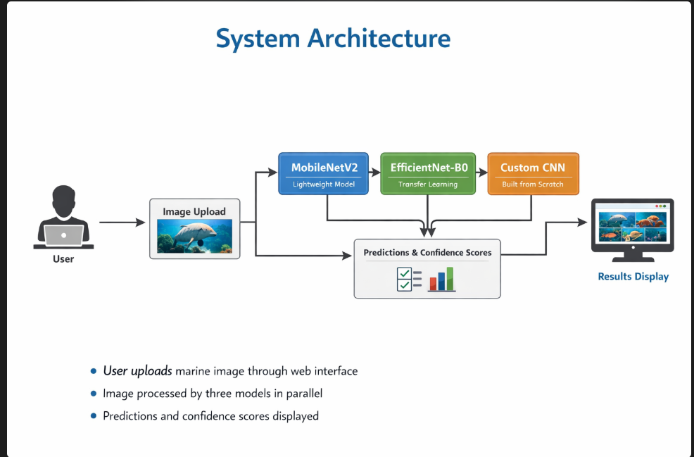
System Architecture
• User uploads marine image through web interface
• Image processed by three models in parallel
• Predictions and confidence scores displayed

Slide 8
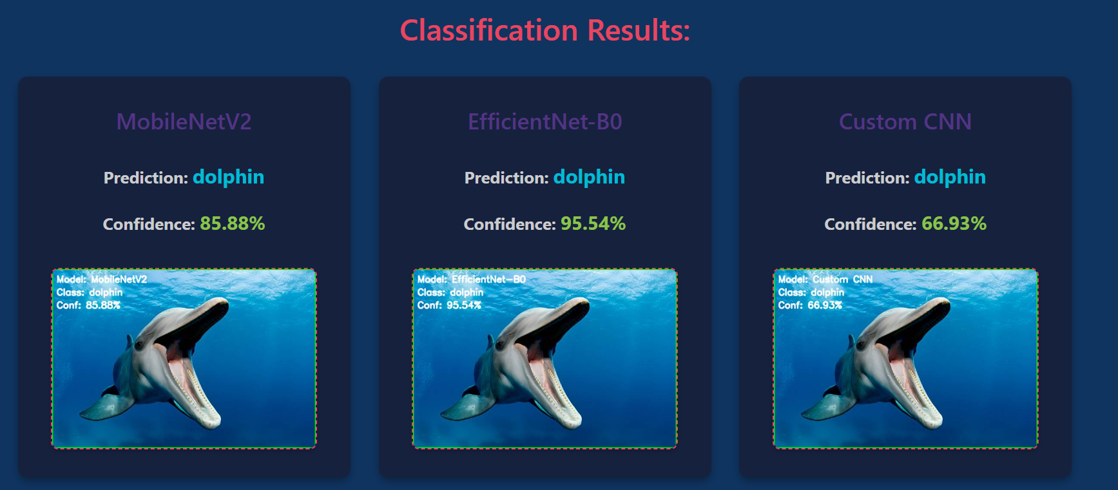
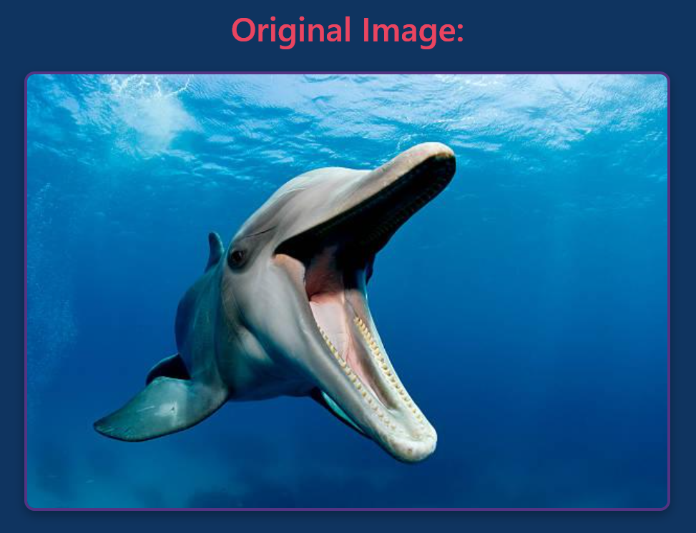
Results
MobileNetV2
EfficientNet-B0
Custom CNN

Slide 9
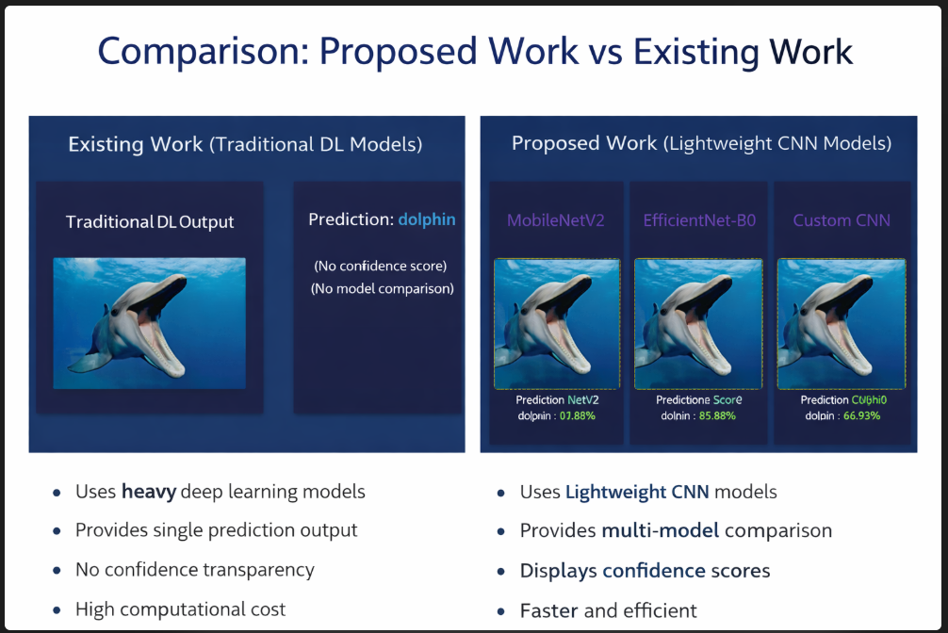
Comparison results
Existing Work
Proposed Work

Slide 10
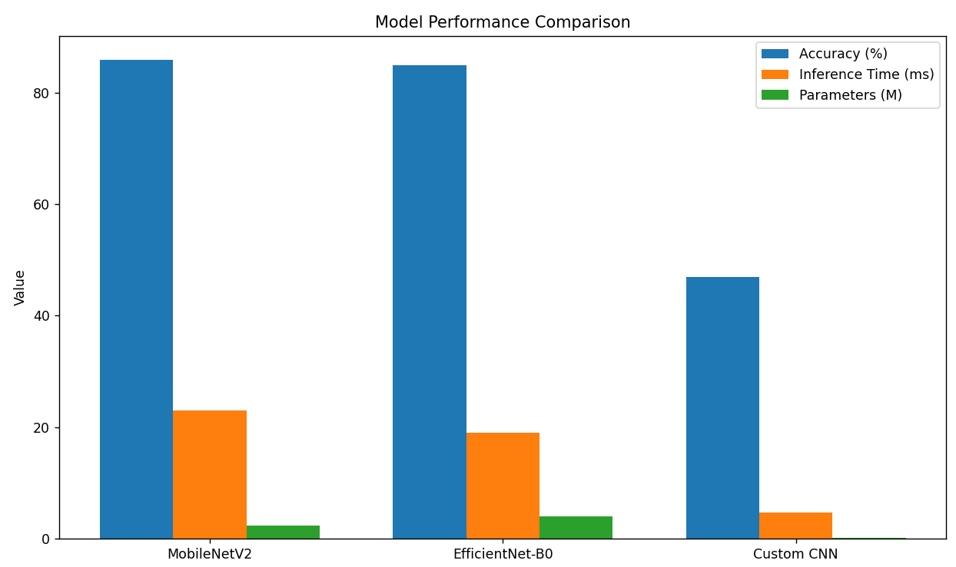
Results-Graph

Slide 11
TOOLS & TECHNOLOGIES
Programming Language: Python
Deep Learning Framework: PyTorch
Computer Vision Library: OpenCV
Web Framework: Flask
Frontend Technologies: HTML, CSS
Image Processing Library: Pillow (PIL)
Numerical Computing: NumPy
Development Environment: Visual Studio Code
Version Control: Git and GitHub

Slide 12
Hardware Requirements
• Processor: Intel Core i5 / AMD Ryzen 5 or higher • RAM: Minimum 8 GB (16 GB recommended) • GPU (Optional for training): NVIDIA GPU with CUDA support • Storage: At least 20–30 GB free space • Internet Connection: Required for dataset download and dependencies
Software Requirements
• Operating System: Windows / Linux / macOS • Python Version: Python 3.8 or higher • Libraries Required:
PyTorch, Torchvision, Flask, OpenCV, NumPy, Pillow
• Web Browser: Google Chrome / Firefox / Edge (for running the web application)

Slide 13
Conclusion
Successfully developed a web-based marine classification system
Implemented and compared three lightweight CNN models
Demonstrated effectiveness of transfer learning
Highlighted accuracy–efficiency trade-offs
Improved transparency through confidence-based predictions
Supports marine research and conservation efforts

Slide 14
Github Repository link
https://github.com/Paidimarrysumanjali/lightweight-deep-learning-models-for-marine-object-classification

Slide 15
Status of the Paper (Outcome-publication)
The paper is currently in the final stage of preparation and will be submitted to a conference shortly.

Slide 16
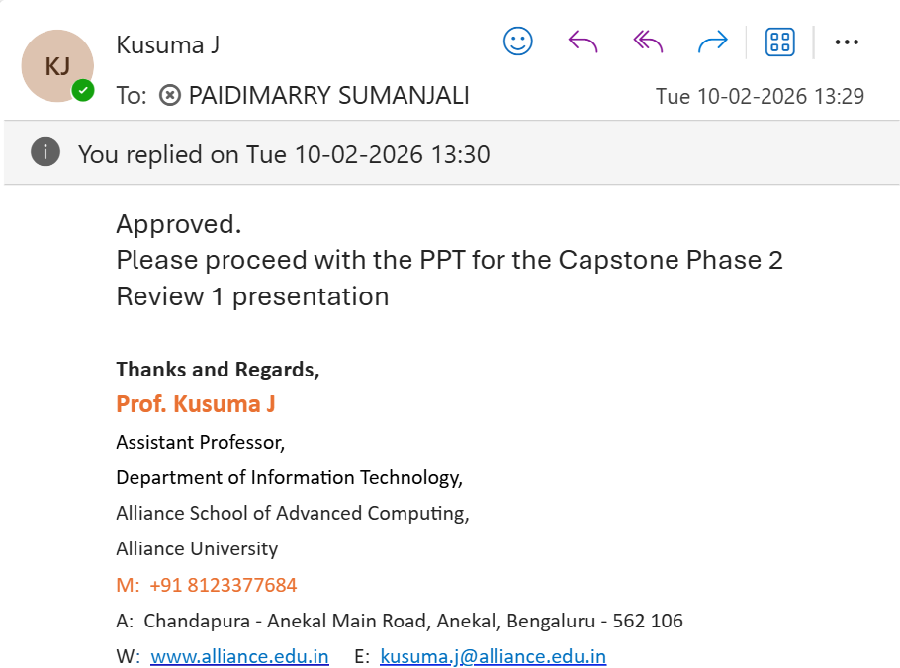
Guide Approval Mail

Slide 17
References
Han, F., Yao, J., Zhu, H., & Wang, C. (2020). Marine organism detection and classification from underwater vision based on the deep CNN method. Mathematical Problems in Engineering.
Mukri, U., & Joshi, B. (2023). Marine debris detection and classification using deep learning techniques. Journal of Information Science and Engineering.
Pokharkar, A., Deshmukh, N., & Biradar, M. (2024). Fish species detection using deep learning. International Journal for Research in Applied Science and Engineering Technology (IJRASET).
Ashabr, M., Halder Mallick, P., Gupta, S. K., & Saha, S. K. (2023). Lightweight DeepSeagrass technique for classifying seagrass from underwater images. Environmental Monitoring and Assessment, Springer.
Gupta, M., & Kumar, A. (2021). Edge AI for real-time classification of marine life using YOLO-Tiny. Ocean Engineering.
Chen, S., Wang, L., & Zhao, T. (2022). Lightweight convolutional neural networks for real-time marine debris detection. IEEE Access.
Huang, J., Zhang, T., Zhao, S., Zhang, L., & Zhou, Y. (2024). An underwater organism image dataset and a lightweight module designed for object detection networks. ACM Transactions on Multimedia Computing, Communications and Applications.
Wang, B., Jiang, P., & Gao, J. (2023). A lightweight few-shot marine object detection network for unmanned surface vehicles. Ocean Engineering, 277, 114329.

Slide 18

Thank You

